Slide 1
From Oracle to PostgreSQL
A hard Journey and an Open-Source Awakening
Notes:
<number>

Slide 2

About Me
Renzo Dani
practical engineer
love DIY projects
climbing, biking and home-made beer
https://github.com/arons
arons7@gmail.com
"Perfection is Achieved Not When There Is Nothing More to Add,
But When There Is Nothing Left to Take Away." (Antoine de Saint-Exupéry)
Notes:
<number>

Slide 3
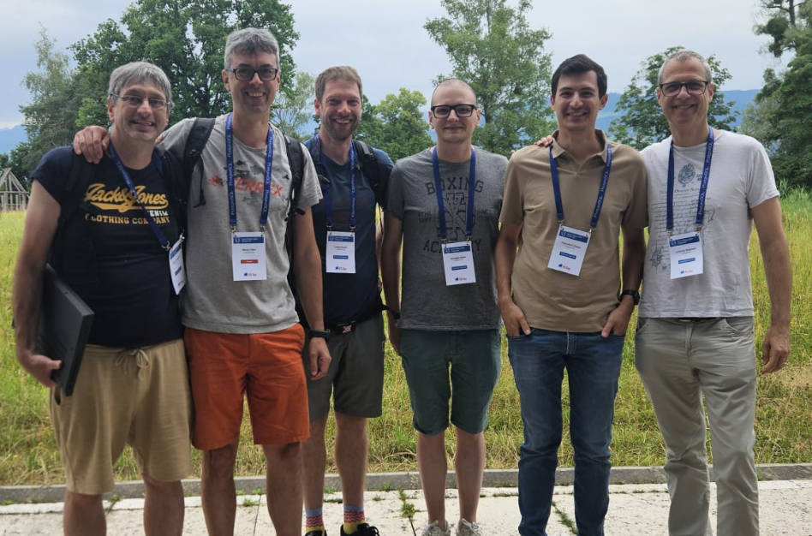
Team LogObject @PGDay
Notes:
<number>

Slide 4

About
LogObject delivers highly customized software for :
Industries: Work Force Management
Police and Rescue service: Operations Control Center
Documentation and Journal management
157 customers
80'000 users
High Customized Application
Mostly on premises deployment
Notes:
<number>

Slide 5
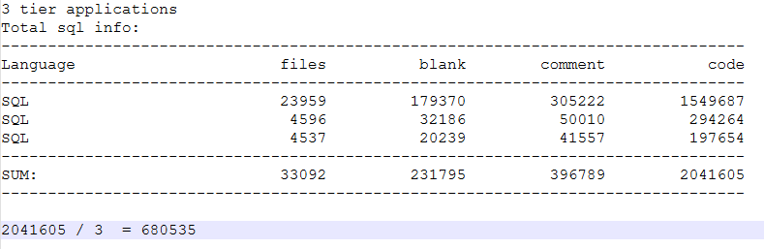
SQL Code Base Size
Files: 33’092
SQL Code lines: ~680'000
Backend in Java
We use Hibernate and JDBC direct access
We have a lot of generated queries
We had a lot of PL-SQL code
Notes:
<number>

Slide 6
Motivation and Goal
Deploy everywhere
Reduce database vendor lock-in
Flexibility and cost
Requirement from customers
Keep compatibility and support
Notes:
<number>

Slide 7
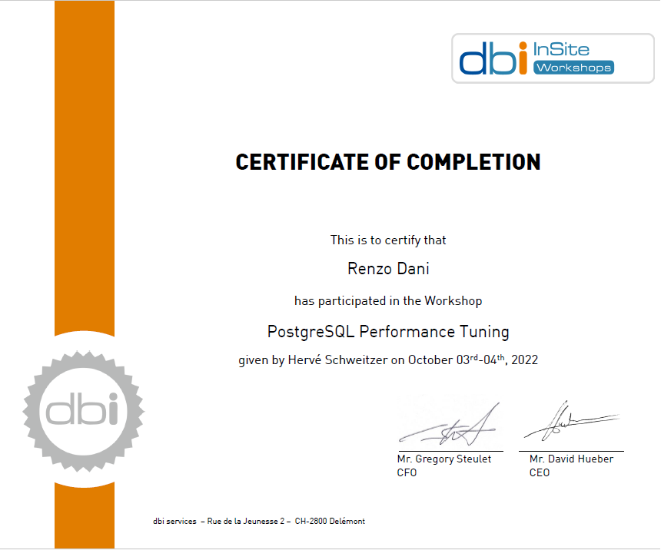
Prepare with solid knowledge
Collaboration and consulting
Personal growth & diploma 😄
Thanks a lot, DBI
Notes:
<number>

Slide 8
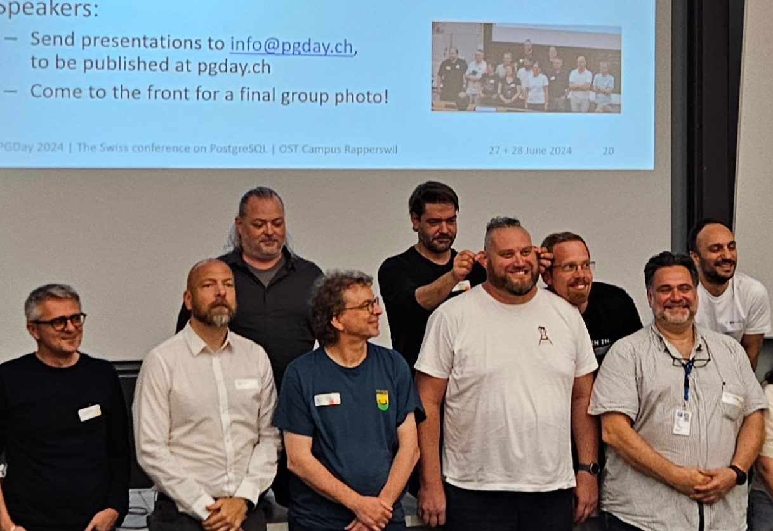
Prepare with solid knowledge
Many thanks to Daniel and PGDay
Notes:
<number>

Slide 9
Evaluation
Write of benchmark tool to compare as much as possible Oracle to Postgres.
We wrote DbBench.
DbBench is testing different usage aspect of the db and is able to do the same tests on Oracle and PostgreSQL using JDBC driver.
That allows us to perform different test cases, test the full stack and learn a lot.
Open source version pg only: https://github.com/arons/jbench
Notes:
<number>

Slide 10
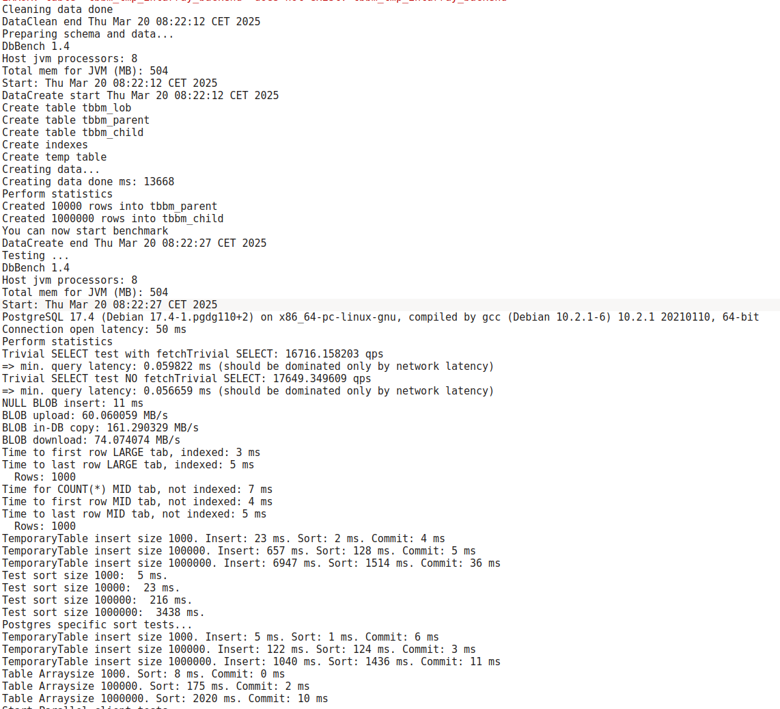
Evaluation
Notes:
<number>

Slide 11
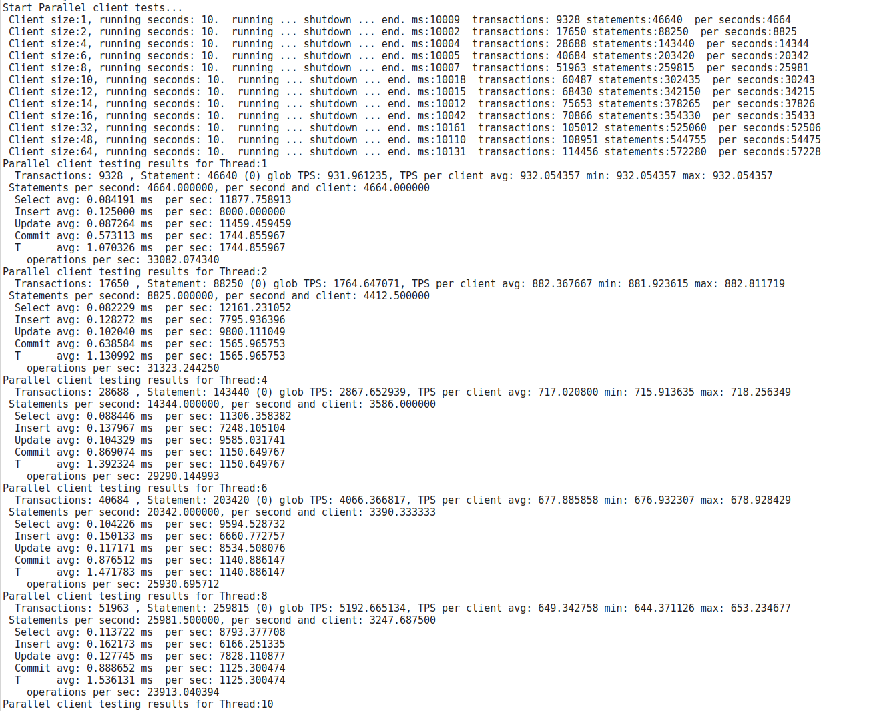
Evaluation
Notes:
<number>

Slide 12
Evaluation
First problem was batch insert were having really bad performance.
Solution was to set reWriteBatchedInserts=true
JDBC batch API, that is PreparedStatement#addBatch(), enables the driver to send multiple "query executions" in a single network round trip.
The current implementation, however, would still split large batches into smaller ones to avoid transmission control protocol (TCP) deadlock.
To prevent the TCP deadlock from being split into multiple blocks, after reWriteBatchedInserts is enabled, insert into () values (),(),()... is supported.
Reference:
https://jdbc.postgresql.org/documentation/use/
https://stackoverflow.com/questions/47664889/jdbc-batch-operations-understanding/48349524?spm=a2c65.11461447.0.0.717db801z6JtyG#48349524
https://vladmihalcea.com/postgresql-multi-row-insert-rewritebatchedinserts-property/?spm=a2c65.11461447.0.0.717db801z6JtyG
https://jdbc.postgresql.org/documentation/head/connect.html?spm=a2c65.11461447.0.0.717db801z6JtyG
Notes:
<number>

Slide 13
Evaluation
DbBench is now our reference tool.
We are using also to validate and evaluate the performance of customer infrastructure.
We extend it also with parameter check and additional network tests.
Notes:
<number>

Slide 14

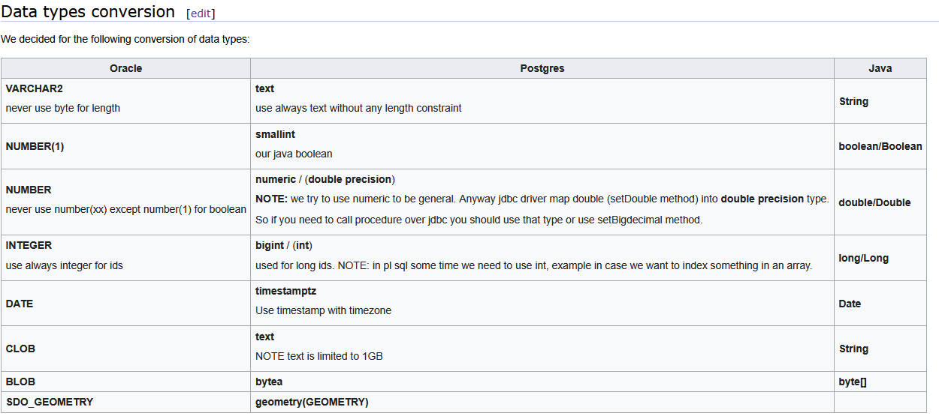
Define a solid base
Build internal knowledge base (iteratively)
Restrict data type usage
Clear data type mapping
Notes:
<number>

Slide 15
Porting Challenges
Minor: functions availability and differences
AUTONOMOUS_TRANSACTION
Oracle implicit casting
Cast in general
Null values and empty string
Data Types: most difficult data type for porting was about time related types
Geo data
“No function matches the given name and argument types”
JDBC differences on data types
Notes:
<number>

Slide 16
Porting Challenges
“No function matches the given name and argument types”
We have function and procedure with a lot of parameters.
Also we have jdbc driver in between.
I tried get help on mailing list...
Notes:
<number>

Slide 17

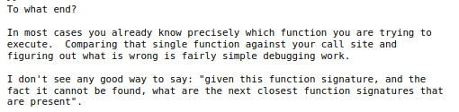

Porting Challenges
“No function matches the given name and argument types”
Reference:
https://www.postgresql.org/message-id/flat/CAFj8pRDwefKugt3ObgMsxx9WZ9v61HghEMD%3DMLGAFgAQbaUMNQ%40mail.gmail.com#293caf793ea7482e71740b7356691d35
Notes:
<number>

Slide 18
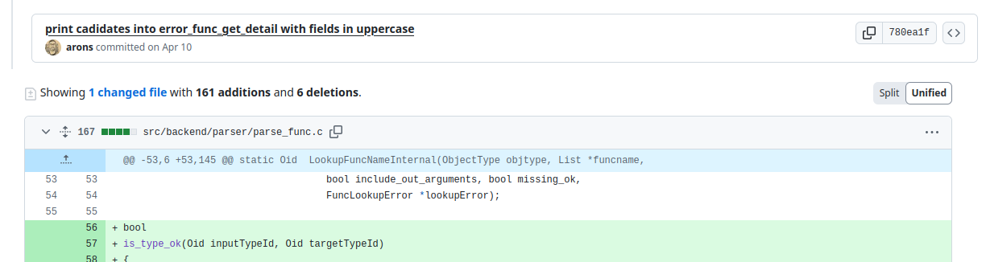
Porting Challenges
“No function matches the given name and argument types”
I ended up patching PostgreSQL to print on log all the matching functions with parameter type and the searched type to manually compare:
Notes:
<number>

Slide 19
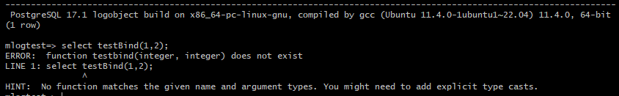
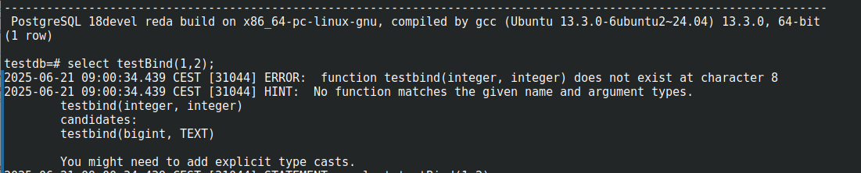
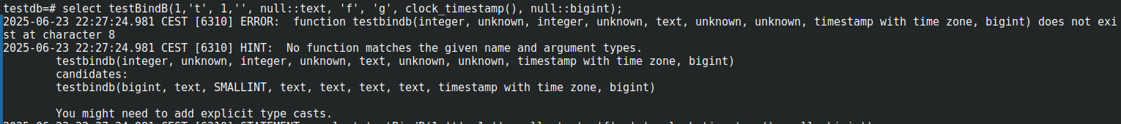
Porting Challenges
Notes:
<number>

Slide 20
Porting Challenges
JDBC differences on data types.
We will concentrate on Date type only.
We follow the pattern:
we store only a time stamp
All necessary conversion for time zone are taken care from the application
“Don't use the timestamp type to store timestamps,
use timestamptz (also known as timestamp with time zone) instead. “
https://wiki.postgresql.org/wiki/Don't_Do_This#Don.27t_use_timestamp_.28without_time_zone.29
Notes:
<number>

Slide 21
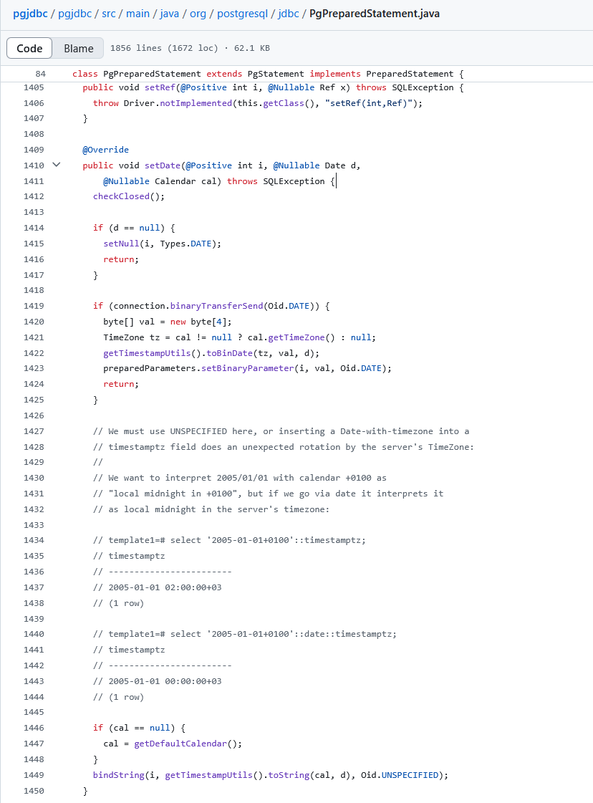
Porting Challenges
https://github.com/pgjdbc/pgjdbc/blob/master/pgjdbc/src/main/java/org/postgresql/jdbc/PgPreparedStatement.java
Notes:
<number>

Slide 22
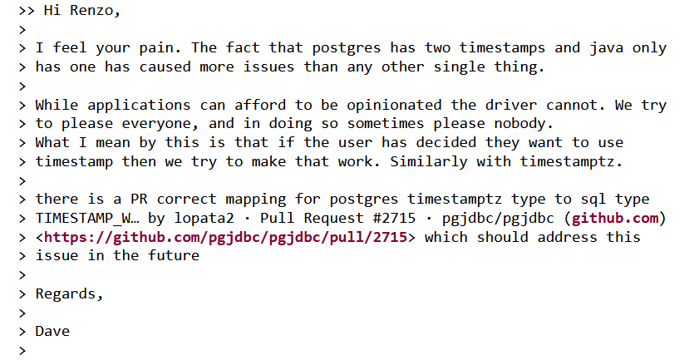
Porting Challenges
I had discussion on mailing list:
https://www.postgresql.org/message-id/flat/CA%2BXOKQDDLn7RjX_i3s5%3DxZH6L3PSQCK83pB3CNgPYBr0uikBmw%40mail.gmail.com#180266b03d80a97f9b666a0da6b8aea0
I did my own pull request: https://github.com/pgjdbc/pgjdbc/pull/3220
Thanks to Dave Cramer for support
Notes:
<number>

Slide 23
Porting Challenges
I had discussion on mailing list:
https://www.postgresql.org/message-id/flat/CA%2BXOKQDDLn7RjX_i3s5%3DxZH6L3PSQCK83pB3CNgPYBr0uikBmw%40mail.gmail.com#180266b03d80a97f9b666a0da6b8aea0
I did my own pull request: https://github.com/pgjdbc/pgjdbc/pull/3220
Thanks to Dave Cramer for support
But hey is open source, we can also have our version:
https://github.com/logobject/pgjdbc
Notes:
<number>

Slide 24
JDBC Driver Experience
Some frustrations
Literal string handling
Great transparency of open-source
Opportunity to contribute and improve
Notes:
<number>

Slide 25
Big Milestone
Schema definition with well defined type
A tool to keep schema align
A benchmark test
A document way how to write code for oracle and PostgreSQL
We built tools for query generations
We built pipelines support for both DBs
We built CI/CD
Notes:
<number>

Slide 26
Database Migration Tool
Notes:
<number>

Slide 27
Database Migration Tool
We started with Ora2Pg.
Was time consuming to:
  understand
  setup correctly
  analyze errors
  some how slow to copy data but we did not dig into it
  Loop over all above
Notes:
<number>

Slide 28
Database Migration Tool
Cause we had all the infrastructure mentioned before.
We only need to migrate data.
We ended up creating our simple migration tool.
Export (written in java):
Is able to define inclusion or exclusion pattern for tables
Is able to define select statement for data
It reads data for table and store is into one or multiple file for table in copy statement
Import:
It requires to have the schema already well defined
Is a simple bash script
First extract info from the target db and generate scripts to drop and create constraints
Start plsq on any exported table data copy
Notes:
<number>

Slide 29
Database Migration Tool
Very simple
Error handling is very easy
Is very flexible :
Export is easy
Export can be done in multiple steps (example first only big tables or a set)
Moving data is moving files
Import can be done easily, table by table, can be repeated
Can only migrate datatypes we used. Other datatypes only added if needed. Most datatypes are represented as string anyways.
Not Open Source: Easy to implement, no general purpose
Notes:
<number>

Slide 30
Finally
We started in 2022
2024 we had our first customer in production
Starting from 2025 new customers are only in PostgreSQL
Notes:
<number>

Slide 31
Oracle Features We Miss
Index skip scan
CREATE INDEX test_objects_i ON test_objects (owner, object_name, subobject_name);
SQL> SELECT owner, object_name
2 FROM test_objects
3 WHERE object_name = 'DBMS_OUTPUT';
…..
2 rows selected.
Execution Plan
-----------------------------------------------------------------------------------
| Id | Operation | Name | Rows | Bytes | Cost (%CPU)| Time |
-----------------------------------------------------------------------------------
| 0 | SELECT STATEMENT | | 2 | 64 | 14 (0)| 00:00:01 |
|* 1 | INDEX SKIP SCAN | TEST_OBJECTS_I | 2 | 64 | 14 (0)| 00:00:01 |
-----------------------------------------------------------------------------------
Notes:
<number>

Slide 32
Oracle Features We Miss
Oracle Flashback
select *
from
tbtask as of timestamp to_timestamp(‘2025-06-27 08:00:00', 'YYYY-MM-DD HH24:MI:SS') t
where t.id = ?
PL-SQL Performances
Notes:
<number>

Slide 33
What We Gained
Deployment flexibility
Fast CI/CD pipelines (fast DB recreation)
Open to new technologies
Already adopting pgvector for AI embeddings
Thanks to open source we have the possibility to understand the software we use and we can contribute to it
Notes:
<number>

Slide 34
Thanks
Open-source community ❤️
All contributors who make this possible
My colleagues @LogObject
Our Customers that support the migration
Notes:
<number>

